Slide 1
The Aging Workforce
Tools & Strategies for Your Organization

Slide 2
The SHRM Foundation
Charity affiliate of SHRM
Empowers HR professionals to build inclusive organizations where all employees thrive and organizations achieve success
Works with SHRM & the Sloan Foundation to produce detailed resources on the aging workforce
Learn more at shrmfoundation.org
Notes:
The SHRM Foundation is leading this initiative. In case you’re not familiar with the SHRM Foundation, it is an affiliate of SHRM and it works to build more inclusive organizations where employees thrive and organizations achieve success.

Slide 3
The Reality: Why this Matters
35% of U.S. labor force participants will be age 50+ in 2022 (Up from 25% in 2002)
45% of unemployed people age 55 to 64 report being unemployed long-term, 27+ weeks (vs. 33% of unemployed 25-34 year-olds)
10,000 Baby Boomers turn 65 every day
Some industries hit hard by Boomer retirements/skills gap:
Educational institutions
Government
Health care
Oil and gas
Manufacturing
How will this affect your workplace? Does your organization have a strategy to recruit, retain and engage these workers?
Notes:
So why focus on the aging workforce right now? Well, here is the big picture in the U.S. More than 1/3 of the labor force will be over age 50 by 2022 (just 5 years away!) People are working longer and delaying retirement. Many of us face challenges in filling open positions, so clearly older workers are an important part of the talent pool that we shouldn’t overlook.

Slide 4
Survey Results
Chapter Survey Results
SHRM Survey Results
[if you have conducted the survey for your chapter or state, add your Aging Workforce survey results here, otherwise, just present the SHRM results]
58% have identified future workforce needs
52% have identified potential skills gaps in the next 1-2 years
35% have analyzed the impact of workers aged 55+ leaving their organization in the next 1-2 years
Notes:
SHRM conducted a national survey of nearly 2,000 HR professionals to ask about their readiness for an aging workforce. It showed that about half of organizations have started the process of analyzing their workforce and their potential skills gaps, but only 35% of respondents have explored what it will mean for their business when older workers begin to retire. As you can see, we all have more work to do to prepare for these changes.
The results for our chapter/state were…. (similar, different, whatever you found in your local survey.)

Slide 5
Dispelling the Myths
Mature workers (age 50+)…
Do not cost significantly more
Fewer organizations base salary on seniority/years of service than in the past
Are more engaged
65% for workers 55+
58% to 60% for younger workers
Are more loyal & less likely to leave after training
Unplanned turnover is often greater among Millennials than Boomers
Notes:
Some companies do not proactively seek older workers due to common misconceptions. For example, thinking they cannot learn new technology, are resistant to change or are too expensive. However research tells a different story. Many of the new SHRM Foundation resources explain in detail the myths vs. realities of employing mature workers.

Slide 6
Top 5 Advantages of Older Workers
77% -- More work experience/knowledge
71% -- More maturity/professionalism
70% -- Stronger work ethic
63% -- Ability to serve as mentors to younger workers
59% -- More reliability
Source: SHRM Preparing for an Aging Workforce Survey
Notes:
Part of the survey asked about the advantages of older workers. Here’s what your HR peers identified. (read list)

Slide 7
Goals of a Mature Worker Strategy
Retain and engage older workers as long as possible
Transfer their knowledge to younger employees
Leverage their skills after they retire
Recruit older talent from outside
Source: SHRM Preparing for an Aging Workforce Survey
Notes:
This is the bottom line: if you want to leverage mature worker talent, you should focus on these areas. Does your company have strategies in place to achieve these goals? If not, then we challenge you to take action.

Slide 8
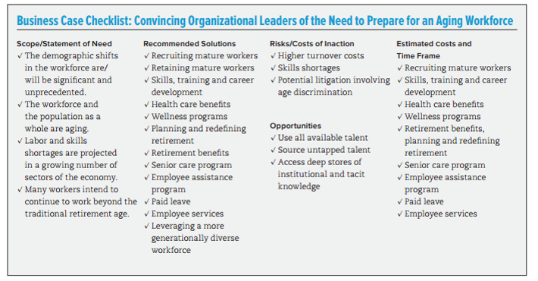
Take Action
Build the business case
Notes:
How do you do that? Here are three easy steps you can follow:
Step one: educate yourself and make the business case to your colleagues and senior management for leveraging older worker talent.

Slide 9
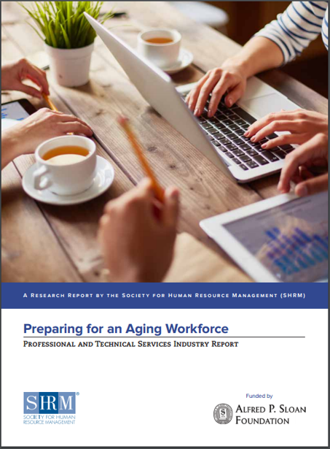
Take Action
2. Assess the state of your aging workforce
Do you need to expand your workforce to meet business demand?
How many workers will be retiring in the next few years?
How will you fill the gaps?
Notes:
Step 2: Assess your current workforce and your future workforce needs. Identify any gaps and start thinking about how to address those.

Slide 10
Take Action
3. Recruit & retain mature workers
Foster an inclusive, age-positive culture
Offer flexible work arrangements
Support health & wellness
Provide caregiver support
Offer targeted skills training
Notes:
Step 3: Review your policies and practices and make changes where needed to support and retain critical older worker talent. You’ll notice that many of the items on this list will also benefit your entire workforce, including offering more workplace flexibility and wellness programs which are very popular with younger workers too.

Slide 11
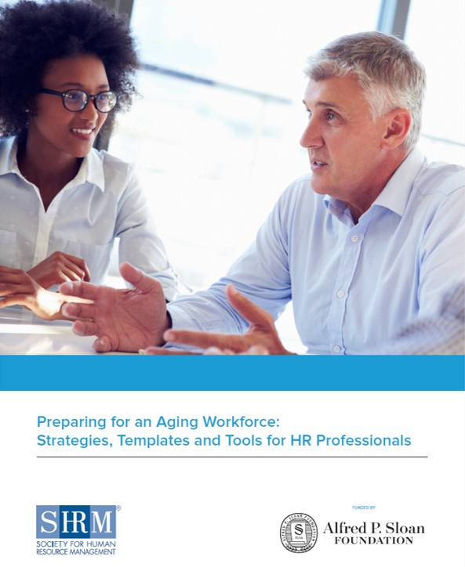
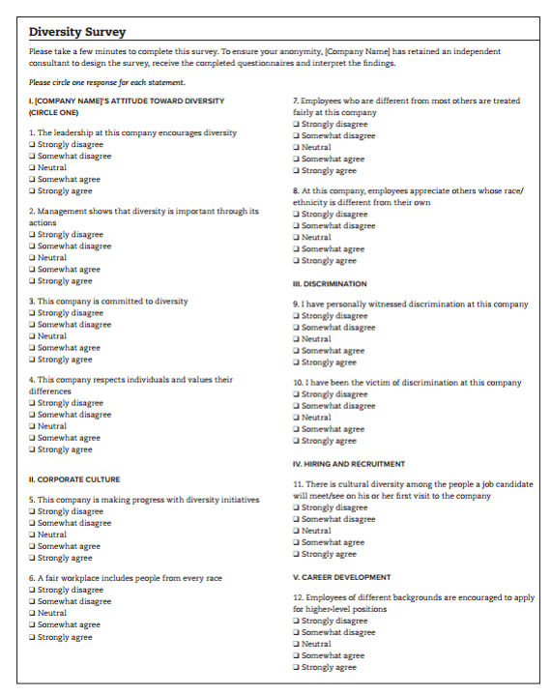
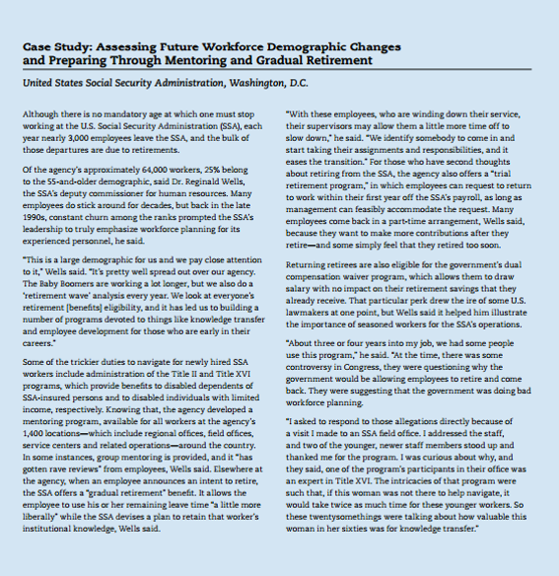
Templates & Tools
Notes:
To help you with these action steps, SHRM and the SHRM Foundation have created a number of easy-to-use, free resources. They will help you analyze the current state of your workforce and then maximize the value of mature workers to your organization.
Your starting point should be this comprehensive guidebook on “Preparing for an Aging Workforce”. It takes you step-by-step through building the business case for older workers, assessing the current state of your workforce, and then developing practical strategies to recruit, retain and engage an age-diverse workforce. It includes worksheets, checklists, quizzes and real-world case studies to guide you along the way.

Slide 12
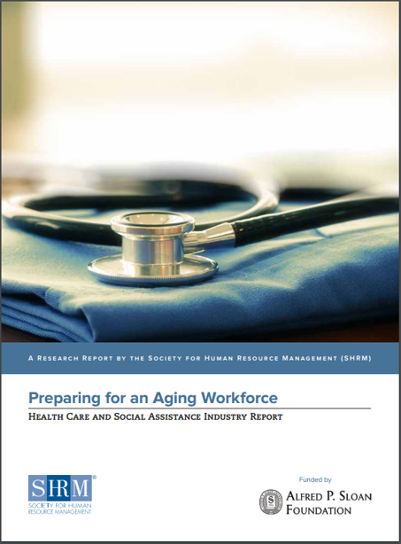
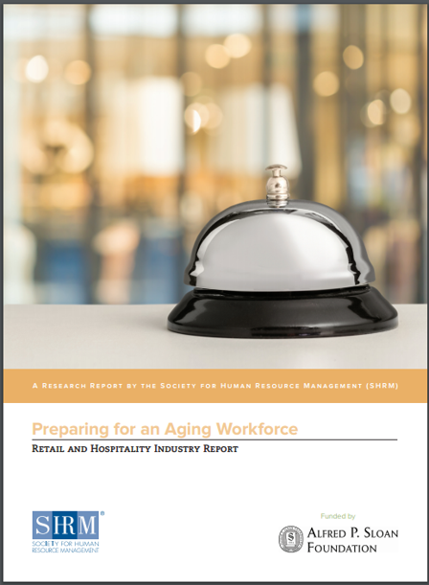
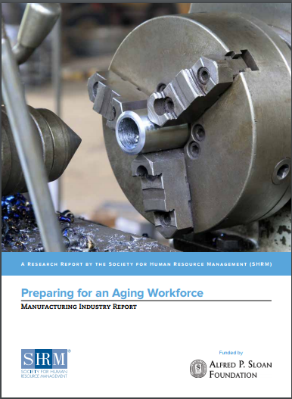
Industry Reports
Get your copy at:
shrm.org/agingworkforce
Notes:
If you want to get customized advice for your particular industry, take a look at this series of special reports. They target seven different industries that have been impacted by an aging workforce: health care, manufacturing, oil, gas and mining, retail, government, finance and professional services. So for customized information that applies specifically to your type of business, please go online and download one of these reports.

Slide 13
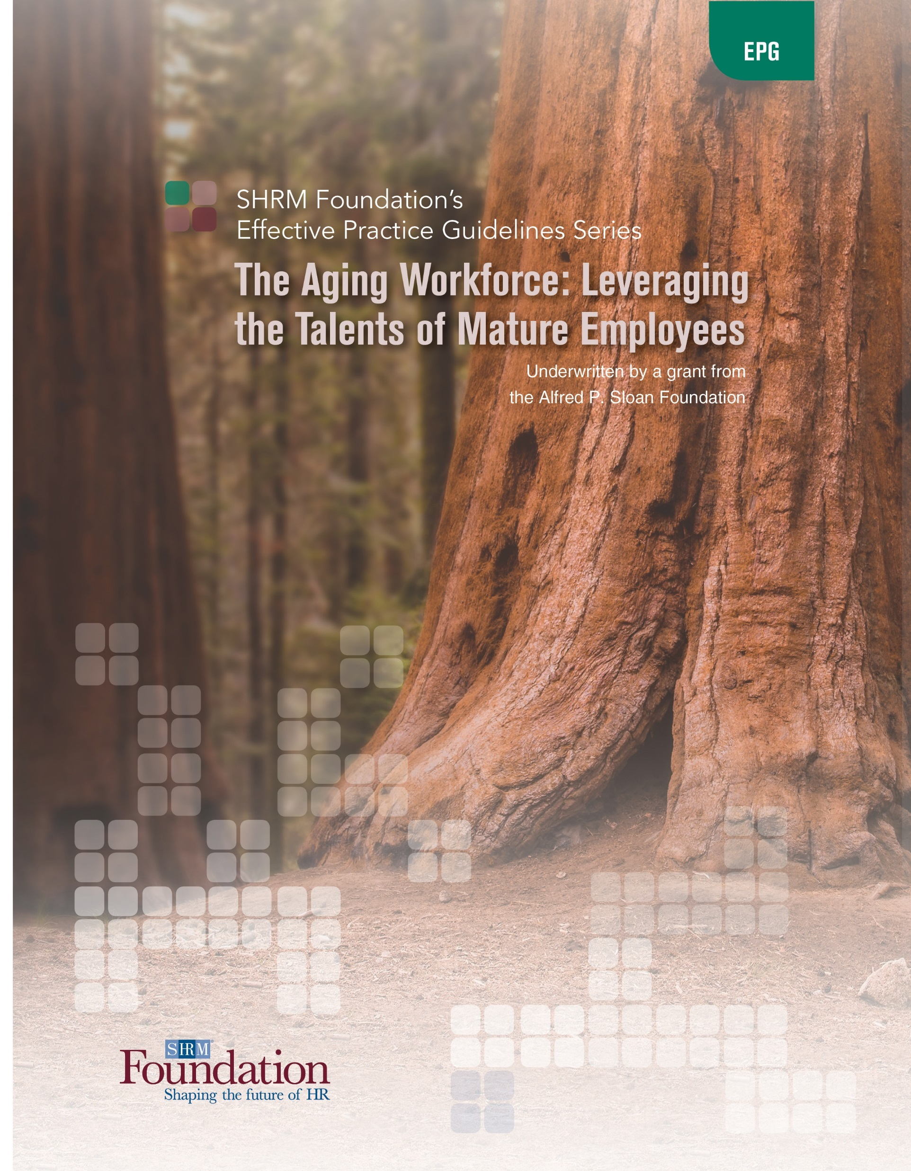
SHRM Foundation Resources
Strategies and best practices from leading companies
Practical guidance for all size organizations
Executive briefings to share with managers
Get your copies at SHRMfoundation.org/aginginitiative
Notes:
When you go to the website, you’ll find additional resources as well including: The SHRM Foundation’s Effective Practice Guidelines report on The Aging Workforce. It provides specific strategies and case studies from a range of companies such as CVS, Mercy Health System, Fidelity and the National Institutes of Health (NIH). It explains how you can implement similar, successful strategies in your own workplace.
In addition the SHRM Foundation has created a variety of short 3-5 page briefings that you can share with your line managers or leaders to help educate them on these issues.

Slide 14
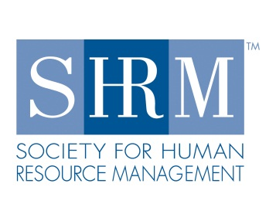
Thank You!
Visit shrmfoundation.org/AgingInitiative
to download complimentary resources
14
Notes:
In conclusion, I hope you have a better understanding now of the challenges and opportunities of the aging workforce and what you can do to prepare. Please visit the website to download these complimentary resources created by SHRM, the SHRM Foundation and funded by Sloan and then take action in your own organization.
Thank you!

