Slide 1
HR Data Management: An Historical, Technological and Global Approach
Introduction

Slide 2
Objectives
Define HRIS and provide examples of how it can be used in a variety of human resource functions.
Understand why project management is critical in the integration of an HRIS.
Apply the basics of project management to an HRIS integration.

Slide 3
Purpose of Lesson
Why
If
What
How
Notes:
Purpose of lesson illustration - with this slide the instructor should inform students why it is important for them to learn the material and connect the topic to them. This would be different depending on the group of students and their specific backgrounds.
Why: Connect the concept to the learner – Explain why students should be interested in this topic.
As all of HR practice is affected by information technology, it is imperative that HR students, as future HR professionals, understand how an HRIS is used in an organization.
What: Deliver information and expert knowledge – Explain what is going to be learned.
In this class students will learn the basics of an HRIS and project management skills.
How: Develop skills and fluency – Explain what the students will be doing to develop their skills.
Students will analyze and write a report on a case study, using project management skills to integrate an HRIS system. In addition, students will participate in class (or on-line) discussions to broaden understanding of the topic and practice decision-making skills.
If: Provide an opportunity for authentic performance – Tell them how this topic will help them if they learn it in a real business environment.
Working independently or in teams, students will practice the skills of an HR professional and demonstrate project management and decision-making skills in a real-world HRIS integration scenario.

Slide 4
Why are these topics together?
?
HRIS
Project Management
Notes:
Project management skills are needed when integrating an HRIS system. The HR professional must understand how project management works. This match of project management and HRIS knowledge is critical for anyone who is going to lead an HRIS integration project. Having just the technical knowledge or just the project management knowledge is not enough for project success.

Slide 5
SECTION #1
HRIS –
HUMAN RESOURCE INFORMATION SYSTEMS

Slide 6
What will be covered in this class?
  HRIS
    What is an HRIS?
    How is it used in organizations?
    The history of HRIS
  Project Management
    Methods of project management
    Project life cycle
    Project management tools and skills
  Integrating an HRIS across cultures
    Integration process
    Integration issues
Notes:
Brief overview of topics to be covered in the class.

Slide 7
HRIS
HRIS Defined
  “HRIS can be briefly defined as integrated systems used to gather, store and analyze information regarding an organization’s human resources.” (Hedrickson, 2003, p.381).
  HRIS “One which is used to acquire, store, manipulate, analyze, retrieve and distribute information about an organization’s human resources.” (Tannenbaum 1990)
Notes:
Provides a definition of HRIS.
Hendrickson, Anthony R., Human Resource Information Systems: Backbone Technology of Contemporary Human Resources; Journal of Labor Research, Summer 2003, Vol. 24 Issue 3, p. 381-394
Tannenbaum, S.I., (1990) HRIS Information: User group implications; Journal of System’s Management, Vol. 41, No. 1 pp. 27-32, 36

Slide 8
HRIS
Not just technology:
  “HRIS is not limited to the computer hardware and software applications that comprise the technical part of the system: it also includes the people, policies, procedures and data required to manage the HR function.” (Hedrickson, 2003, p.381).
Notes:
It’s interesting to note how Hendrickson broadens the definition of HRIS to include people, policies and procedures and not just the technology itself.
Hendrickson, Anthony R., Human Resource Information Systems: Backbone Technology of Contemporary Human Resources; Journal of Labor Research, Summer 2003, Vol. 24 Issue 3, p. 381-394

Slide 9
History of HRIS
Early (pre-WW II)
  Personnel
    Old term for human resources
    Historically isolated from core organizational functions
  Record keeping
    Name, address, phone, employment history
Notes:
Early HR, then called personnel, was limited to employee record keeping and was provided as a service to the organization. There was no HRIS as we know it today – Personnel record keeping was done by hand, oftentimes utilizing a system as simple as an index card file. The personnel department was typically small with little power and limited interaction with the organization’s business mission.
See: Hendrickson, Anthony R., Human Resource Information Systems: Backbone Technology of Contemporary Human Resources; Journal of Labor Research, Summer 2003, Vol. 24 Issue 3, p. 381-394
The instructor could supplement the history slides by using additional information from a basic HRIS or HR text book which covers the HRIS topic.

Slide 10
History of HRIS
Between 1945 and 1960
  Human capital issues
  Employee morale
  Formal selection and development
  No real changes from earlier days
Notes:
After WWII organizations became more aware of human capital issues recognizing the importance of employee morale in the success of organizations. Formal selection and development processes were developed but there was no real change from the original responsibility of the “personnel” department – that of record keeping. As record keeping was still done by hand, HR information systems, pre-1960, hardly gave a hint of what they would become with the advent of workplace technology.
See: Hendrickson, Anthony R., Human Resource Information Systems: Backbone Technology of Contemporary Human Resources; Journal of Labor Research, Summer 2003, Vol. 24 Issue 3, p. 381-394

Slide 11
History of HRIS
Early (1960s to 1980s)
  Personnel became HR
  HR was seen as key in organizations
  Government and regulatory agencies increased reporting requirements:
      Affirmative action
      EEO
      OSHA
  Still, HRIS was used mostly for keeping administrative records
Notes:
In the late 1960’s and 1970’s the term “human resource management” gained common usage in place of the term “personnel” and by 1974 the new term, human resource management, was appearing in media headlines and was eventually shortened to just “HR.”
From the 60’s to the 80’s organizations firmly integrated HR into their core business missions. At the same time regulatory reporting requirements for employees increased significantly. Large organizations used mainframe computers to maintain organization data bases and technology based Human Resource Information Systems (HRIS) provided an efficient solution for the increased record-keeping and reporting required by government regulation. The human resources department became one of the most important users of the organization’s computer systems, though the primary task was still record-keeping.
See: Hendrickson, Anthony R., Human Resource Information Systems: Backbone Technology of Contemporary Human Resources; Journal of Labor Research, Summer 2003, Vol. 24 Issue 3, p. 381-394

Slide 12
History of HRIS
Contemporary HRIS
  Large and small businesses are utilizing HRIS
  Personal computers have made HRIS available and affordable for any sized firm
  HRIS has evolved from simple record-keeping to complex analytical tools to assist management decision making
Notes:
See: Hendrickson, Anthony R., Human Resource Information Systems: Backbone Technology of Contemporary Human Resources; Journal of Labor Research, Summer 2003, Vol. 24 Issue 3, p. 381-394

Slide 13
Who uses HRIS and how is it used?
HR Professionals
  Reporting and compliance
  Payroll and compensation analysis
  Benefits administration
  Applicant tracking, skills inventory
Functional Managers
  Performance management and appraisal
  Recruitment and resume processing
  Team and project management
  Training and skills testing
  Management development
Notes:
Contemporary HRIS must be versatile enough to meet the needs of multiple organization stakeholders. HRIS is commonly used by HR professionals as well as by managers in functional areas. All have different needs for the information provided by a central data system.

Slide 14
Who uses HRIS and how is it used?
Individual Employees
  Self-service benefit options
  Career planning
  Training and development
Notes:
As organizations add self-service centers, employees use the HRIS for benefit selection and enrollment. Career planning and records of training and development can be maintained by the employee themselves thereby keeping the records up to date and saving labor, and therefore cost, for the HR department.

Slide 15
Benefits of HRIS
Increased Efficiency –
  more transactions with fewer resources
Increased Effectiveness –
  more accurate information and simplification of processes
Notes:
Efficiency
According to Hendrickson (2003) increased efficiency is a benefit of an HRIS. Both time and cost efficiency can be addressed with the ability to do more transactions with fewer fixed resources. This can specifically be seen in areas such as payroll and benefits.
Effectiveness
In terms of accuracy, the HRIS helps in transactions. Additionally, the technology can be used to simplify processes (Hendrickson, 2003).
Some information is only available through technology. Many types of computer-based training, internet access to the recruitment world, and the use of certain programs to assess employees in the hiring process are only available for those with technology-rich environments.

Slide 16
HRIS Terminology
HRIS –
  Generic term referring to any information system used for obtaining relevant and timely information on which to base human resource decisions. (Mondy)
ERP –
  Enterprise Resource Planning
  Software system that integrates several data sources and processes into a unified system. An ERP system provides the functions of at least two separate systems. i.e. Accounting and Inventory Management. (www.bestpricecomputers.co.uk)
Notes:
Mondy, R. Wayne, Human Resource Management, © 2008, Pearson Prentice Hall
www.bestpricecomputers.co.uk/glossary (retrieved 7/1/08)

Slide 17
HRIS Terminology
SAP –
  System Applications and Products
  World’s largest business software company providing integrated software systems. In business since 1972
Discussion –
  What are some examples of HRIS systems, including both ERP and stand alone?
Notes:
SAP – www.sap.com (retrieved 7-1-08)
Stand alone HRIS systems
People-Trak www.people-trak.com
ERP integrated systems
SAP – www.sap.com
Hexaware – www.hexaware.com

Slide 18
Discussion Topics
Provide specific examples of HRIS systems and provide the details (costs, system requirements and web site resources etc.).
What are the strengths of the systems?
What are the weaknesses of the systems?
Respond to other student’s examples.
As a group, decide which HRIS is best for a large organization and which one is best for a small organization.
Notes:
Provides instructor a possible topic for an asynchronous online discussion or for in-class discussion.

Slide 19
Discussion Activity
What are your perceptions of an HRIS?
  Possible discussion topics:
    List HRIS software you have heard of and what functions they can complete.
    What can an HRIS do for an organization?
    List why your organization would want or does use an HRIS.
Notes:
This slide can be used by the instructor to facilitate a class or online discussion. Responses to the discussion questions will vary based on the type of organization and the instructor should be able to determine the appropriateness of answers based on knowledge.

Slide 20
SECTION #2
PROJECT MANAGEMENT

Slide 21
Project Management
Project Management –
  a carefully planned and organized effort to accomplish a specific (and usually) one-time effort.
    www.managementhelp.org (retrieved 7/2/08)
  A project is a series of tasks and activities that has a stated goal and objectives, a schedule with defined start and end dates, and a budget that sets limits on the project’s dedicated use of resources.
      SHRM Learning System, © 2008 , Module One Strategic Management, p. 1-21
Notes:
There are a number of accepted definitions of project management. They all refer to a project as a planned and coordinated activity that has a specific timeline and objectives. Generally a project is a one-time event.
www.managementhelp.org (retrieved 7/2/08)
SHRM Learning System, © 2008 , Module One Strategic Management, p. 1-21

Slide 22
Project Management
Projects are characterized by –
  A group of people
  A goal
  Limited time and money
  A level of uncertainty regarding achievement
Notes:
Generally projects are carried out by a team comprised of a group of people from different backgrounds each of whom contributes knowledge and skills in their various areas of expertise. An organization may establish a project team using individuals from different departments of the organization.
A project always has a desired result. When a project is completed, something new has been accomplished – a new product is launched, new software is developed or a new process is implemented.
Resources are always limited, particularly in time and money. Good project planning requires an accurate assessment of the project costs and a schedule projection for completion. It is imperative that the team monitor budget and scheduling during all phases of the project as success is dependent upon staying within budget and meeting projected deadlines.
As a project always results in something new, one characteristic of a project is that success is never guaranteed beforehand. There is always uncertainty and risk. Will our new product be well received in the marketplace? Will the new software function as expected? Will the new process generate a positive return on investment? Even is we reach the desired goal, will we accomplish our task on time and within budget? Projects contain many variables and therefore, uncertainty and risk are simply a part of the process.
Baars, Wouter; Project Management Handbook, Version 1.1 – July 2007; DANS – Data Archiving and Networked Services; The Hague – 2006 http://www.projectmanagement-training.net (retrieved 7/2/08)

Slide 23
The Process of Project Management
Project Management Life Cycle
  Defining (Scoping)
    Answers the question – What will be covered by this project?
  Planning
    Identifies: Who, What, When and With what resources
  Executing
    Organizing people, allocating resources and scheduling tasks
  Monitoring and Controlling
    Tracking progress and taking corrective actions
  Closing
    Project completion and evaluation
Notes:
Research has given us a number of different models of project management. Some models are linear with projects moving sequentially through four to six distinct stages. Some models are cyclical indicating that a project may move back and forth between stages as needed with some overlap in process.
The model on this slide is an example of a linear model of project management.
See: www.bgsu.edu

Slide 24
The Process of Project Management
The MPMM Project Management Life Cycle
  Project Initiation
    Project Definition
  Project Planning
    Detailed Planning
  Project Execution
    Monitoring and Control
  Project Closure
    Post Implementation Review
    www.mpmm.com/project-management-methodology
Notes:
The process designed by MPMM identifies four major stages of project management with four subsections completed after each stage. This is another linear model of project management.
See: www.mpmm.com/project-management-methodology

Slide 25
The Process of Project Management
The Rational Unified Process (RUP)
  The Inception Phase
    Primary goal is to achieve consensus on project objectives and to obtain funding for the project
  The Elaboration Phase
    Identifies details of the project and architecture for the system
  The Construction Phase
    Development of the new system to the point where it is ready for deployment
  The Transition Phase
    The focus is on delivering the system into production, testing and fine tuning
Notes:
The Rational Unified Process (RUP), originally designed by IBM specifically for software development, is structured in phases which represent the four major stages that a project goes through from inception to completion. Within each phase are subsections called, disciplines, which represent the activities that take place throughout the project.
Ambler, S.W. (2005) A Manager’s Introduction to The Rational Unified Process (RUP) EBSCOhost (retrieved 7/1/08)

Slide 26
The Process of Project Management
DANS –
Initiation phase – Idea
  Are we going to do this project?
Definition phase – What?
  Is it possible? What is required?
Design phase – How?
  Is it desirable? What will be the result?
Development phase – How to implement?
  Is it feasible? How will we implement the project?
Implementation phase – Carrying out the project
  Is the result adequate? How will we evaluate the project?
Follow-up phase – Maintenance
  Final report
Notes:
DANS – Data Archiving and Networked Services
DANS identifies a traditional six phase linear process of project management with a critical decision point after completion of each stage. The decision point is a time for recording the current status of the project and an opportunity to reconsider the project phases and make any necessary corrections. These decisions are oftentimes “go/no go” moments that call for determining whether to proceed with the project or whether it should be discontinued.
Baars, Wouter; Project Management Handbook, Version 1.1 – July 2007; DANS – Data Archiving and Networked Services; The Hague – 2006 http://www.projectmanagement-training.net (retrieved 7/2/08)

Slide 27
Project Management Systems for Software Development
Linear process – Waterfall model
Cyclical Project Management
  Preferred for software development
    Software development is a creative process
    Impossible to identify all requirements beforehand
    Difficult to estimate amount of time necessary for implementation
    Intermediate results must be tested by users throughout the entire project
Notes:
The four previous slides depicted project management systems that were all linear systems, also called Waterfall Models as each stage in the process occurs sequentially. Just as a waterfall moves in only one direction, the pure waterfall method does not allow returning to a phase after it has been completed.
For a number of reasons, a cyclical method of project management is preferred for software development (Baars 2006)
Baars, Wouter; Project Management Handbook, Version 1.1 – July 2007; DANS – Data Archiving and Networked Services; The Hague – 2006 http://www.projectmanagement-training.net (retrieved 7/2/08)

Slide 28
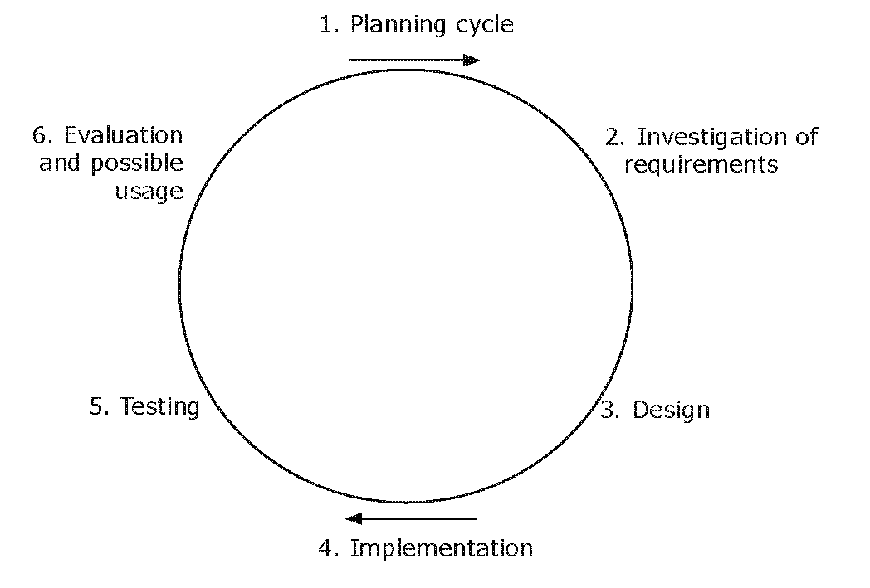
Cyclical Project Management
DANS 6-stage project management method depicted as a cycle instead of a linear process
Notes:
“In cyclical project management, the project goal is pursued in several short successive consecutive cycles. Each cycle is relatively short, preferably lasting less than one month. Within each cycle, a portion of the project is carried out. This is fundamentally different from the waterfall method, in which these activities all take place within their own separate phases. In addition, the waterfall method prescribes only single moments for definition, design, implementation and testing. In the cyclical method, this occurs many times in sequence.” (Baars – 2006 Fig. 9)
Baars, Wouter; Project Management Handbook, Version 1.1 – July 2007; DANS – Data Archiving and Networked Services; The Hague – 2006 http://www.projectmanagement-training.net (retrieved 7/2/08)

Slide 29
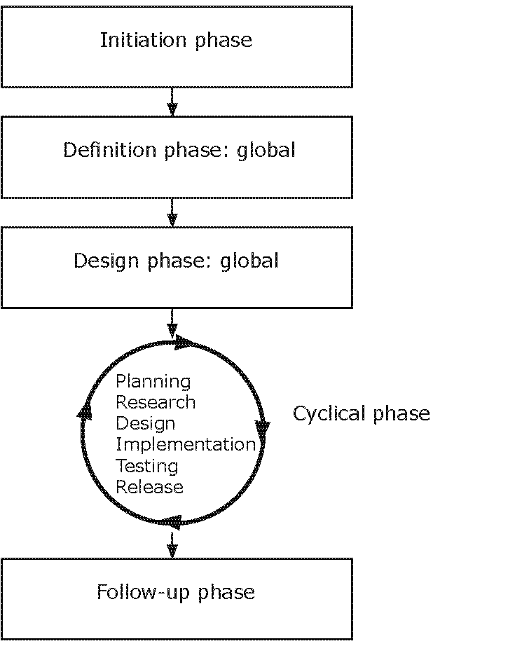
Project Management
DANS Software-Development Method
Notes:
DANS software-development method is a blend of linear and cyclical methods of project management intended to achieve the benefit of both models. The initial phase is represented as a linear process followed by a cyclical phase where team members can move freely back and forth through the process, implementing procedures as needed, until completion of the project.
Baars, Wouter; Project Management Handbook, Version 1.1 – July 2007; DANS – Data Archiving and Networked Services; The Hague – 2006 http://www.projectmanagement-training.net (retrieved 7/2/08)

Slide 30
Discussion Activity
What is the hardest for the HR professional to control in a project (time, cost, scope)?
What can the HR professional do to help ensure success in time, cost, and scope?
Notes:
This slide can be used by the instructor to facilitate a class or online discussion.
The answer for this question may vary but for enhancements and maintenance.
For maintenance, many times scope is set so only time and cost can be controlled. For example if a new law is enacted, you must add it.
Enhancements allow for the addition of new functions or features. You are able to set scope better. What is the hardest for the HR professional to control?
That depends on the perspective of the project.

Slide 31
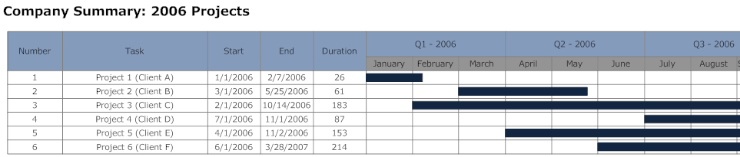
PM Tools – Gantt Chart
Notes:
There are a number of planning and scheduling tools used by project managers. This slide is an example of a Gantt Chart (developed by Charles Gantt in 1917) which is a simple horizontal bar chart depicting the sequence of tasks necessary for completion of a project. Each task is represented by a horizontal bar, the length corresponding to the time necessary for completion. A Gantt Chart is an excellent visual depiction of the time when specific tasks must start and when they must be completed.
http://gates.comm.virginia.edu/rm2n/teaching/gantt.htm

Slide 32
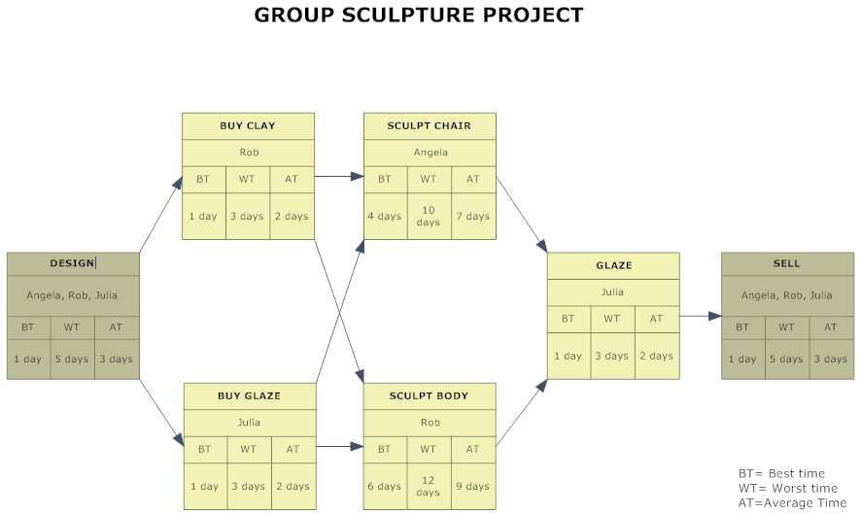
PM Tools – PERT Chart
Notes:
PERT stands for Program Evaluation Review Technique and was originally developed by the U.S. Navy in the 1950’s to manage very large complex projects that had a high degree of task dependency. A PERT chart is typically used to identify the sequence of tasks and to show which tasks must be completed before other tasks may be started. Tasks that must be completed in sequence are called dependent or serial tasks and those that may be completed independent of other tasks are referred to as parallel or concurrent tasks.
http://gates.comm.virginia.edu/rm2n/teaching/gantt.htm

Slide 33
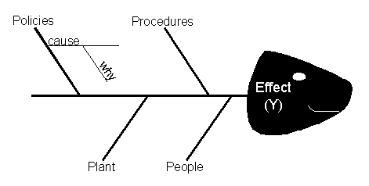
PM Tools – Fishbone Diagram
Figure 1: Fishbone Diagram Example
Notes:
The Fishbone Diagram (the Ishikawa diagram) is a chart of cause and effect. It is a tool for identifying the root causes of quality problems.
http://mot.vuse.vanderbilt.edu/mt322/Ishikawa.htm

Slide 34
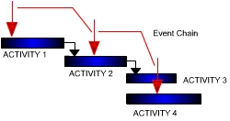
PM Tools – Event Chain
Notes:
The Event Chain Diagram is similar to a Gantt Chart in its use of horizontal bars to depict the sequence of activities. A Risk Event Chain Diagram includes the use of red arrows to identify risk events that may occur in the sequence of activities. Risks events may be associated with certain tasks or at certain time intervals on the event chain. This diagram gives a visual model of risks and uncertainties.
Http://www.maxwiderman.com/guest/event_chair/tracking.htm

Slide 35
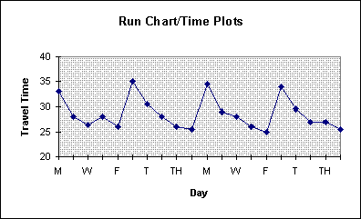
PM Tools – Run Chart
Notes:
A Run Chart plots a series of events over a period of time. The events are plotted along the horizontal axis of the diagram and then linked giving a visual of high and low points over a specific period of time. A run chart is often used for tracking activities over time.
http://deming.eng.clemson.edu/pub/tutorials/qctools/runm.htm

Slide 36
Project Management Software
Desktop
  Microsoft Project
  Cerebral Project
Web based
  @task
  Project Insight
Opensource
  Kplato
  Openwork Bench
  dotProject
Notes:
There are a number of software project management applications available that provide helpful tracking and reporting systems for the project manager. Some are desktop applications which are available for outright purchase, with the software then loaded onto the individual’s computer. Desktop systems are most commonly used by small businesses where projects are managed by one, two or a small number of employees. They would not be practical for large organizations with complex projects managed by a large project team whose members are located at various geographic sites.
Microsoft Project is a stand alone desktop system that works much like other Microsoft Office Products. It’s priced from $600 - $1000 depending on the system chosen and the features available. http://office.microsoft.com/en-us/project/default.aspx
Cerebral Project is another desktop system that is available for purchase and is priced between $200 - $400. http://www.cerebralproject.com/
Web-based systems are available on-line and are generally used for larger, more complex projects where members of the project team may be scattered at various geographic locations. In a web-based system there is no need for client-side software. Web-based systems are purchased through licensing fees that include an initial payment plus annual charges. There are a variety of prices available depending on the system used. Some systems even provide on-site consulting, but the process can be expensive.
@Task is a web-based system used by large industries such as Boeing, Cisco Systems, Johnson & Johnson and Walt Disney. See: http://www.attask.com/
Project Insight – Another web-based system appropriate for project teams at multiple locations. See: http://www.projectinsight.net/
Opensource systems are free to the public and available on-line.
Kplato – Opensource http://www.koffice.org/kplato/
Openwork Bench – Another opensource system found at: http://www.openworkbench.org/
dotProject is a free system where there is no “real” company behind the product. It is managed, maintained, developed and supported by a volunteer group and by the users themselves. http://dotproject.net/

Slide 37
Discussion Topics
Provide an example of a project management tool and discuss how it could be used.
Provide one software resource and identify its strengths and weaknesses.
Notes:
Possible discussion topics, either in the classroom or on a discussion board.

Slide 38
SECTION #3
MANAGING PROJECTS AND HRIS

Slide 39
Managing Projects
Control Factors
  Time
    Scheduling / Gnatt and PERT Charts
  Money
    Budget projections
  Quality
    Good enough is good
  Organization
    Managing the project team
  Information
    Communication and decision making
Notes:
Project managers direct functions along these five parameters known as control factors. There are a number of methods such as Gnatt and PERT charts that are used to schedule time and tasks.
Experienced project managers take a pragmatic attitude towards levels of quality within a project realizing that projects that strive to achieve the highest possible levels of quality are often at greatest risk of never being completed. Therefore, “good enough is good.”
Certainly communication is essential between members of the project team, but it is also important that other stakeholders be kept informed of progress on the project. Regular progress reports are an expected part of the process.

Slide 40
People and the Project
Project Stakeholders and Tasks
  The Project Sponsor
    Member of management
    Leadership role in getting project approved, funded and off the ground
  Organizational Management
    Identifies need for the project
    Approves budget and assesses risk
Notes:
There are a variety of stakeholders involved in every project. The project usually starts with a project sponsor whose role is to win support for the project from senior management. From there, senior management will assess the risks of the project and approve the resources necessary for completion. Throughout the life of the project the sponsor continues to report progress to senior management and remains a vital link between the organization and the project team. Because of their continuing support for the project, the project sponsor is sometimes called the project “champion” or “cheerleader.”
www.projectmanagementcertification.org/managernotes/roles_and_responsibilities
SHRM Learning System, © 2008, Module One Strategic Management, pgs. 1-22 – 1-24

Slide 41
People and the Project
Project Stakeholders and Tasks
  The Project Manager
    Manages the team and the process, has ultimate responsibility for project success
  Roles of the Project Manager
    Interpersonal
    Informational
    Decisional
Notes:
The project manager has overall responsibility for the project therefore this position should be assigned as early as possible in the project lifecycle. The project manager is responsible for completing the project on time, within budget and meeting the requirements and quality levels of the project.
There are a number of responsibilities in managing a project. Generally the responsibilities fall within one of the three roles.
Interpersonal – The project manager is the leader of the team and a liaison between the team members and the rest of the stakeholders.
Informational – The project manager is the spokesperson for the project. He/she insures open communication between team members and communicates information about the progress of the project to others in the organization.
Decisional – The project manager allocates resources, assigns tasks, resolves conflict and encourages progress toward completion.
SHRM Learning System, © 2008, Module One Strategic Management, pgs. 1-22 – 1-24

Slide 42
People and the Project
Project Stakeholders and Tasks
  The Project Team
    Carries out the activities for project completion
Notes:
The project team consists of any number of members with the skills necessary to complete the tasks required by the project. It is likely there will be team members representing a wide variety of departments within the organization, all depending on what is needed as dictated by the nature of the project. For integration of an HRIS process there would be HR staff on the team as well as members from the IT department. A project team for a long-term complicated project for a multi-national organization would consist of a large number of team members from a variety of disciplines as well as from dispersed geographic sites within the organization.

Slide 43
Communications
Within the Project Team
  Kick-off meeting
    Communications Plan: who, when, what, how
    Review/scope
    Technical review
  Establish how the team will be informed of issues and decisions
    Face-to-face
    Email
    Virtual teams
  International communications
    One voice
    Language of customer
  Informing stakeholders
Notes:
Regardless of the nature of your project, projects are more about people than about technology. A successful project manager must foster communication within the team members and insure progress is communicated as needed to the various stakeholders.
A communication plan should be agreed upon at the project kick-off meeting. This should establish the parameters of communication among the team members. The plan should provide methods for regular communication among team members. It should answer the questions: When should formal communication take place? What should be communicated? How will it be communicated? Who is responsible? The kick-off meeting should also review the scope of the project and insure the technical requirements of the project can be met.
If the project involves international team members or stakeholders, the issue of language must be addressed. Does the communication need to be in multiple languages? If so, what language(s) will be used for project information and reporting?
It is important that all stakeholders receive regular communication on the progress of the project or the team may find that support for their project diminishes over time. The project manager or the team must decide who is responsible for communicating with the stakeholders, how often communication should occur and how it will occur.

Slide 44
Leadership
Effective Project Managers
  Problem-Solving expertise
  Leadership expertise
  Context knowledge
  Analytical skill
  People skills
  Communication skills
  Administrative expertise
Notes:
Studies indicate that effective project management must be more than simply bringing in the project “on time, in budget and to scope.” According to research by Brill, Bishop and Walker, the number one skill of an effective project manager is problem-solving expertise, followed by leadership ability.
Evidence would indicate that the “soft” skills of managing people, such as team-work, communication, negotiation and conflict resolution, are equally important, if not more important than the technical and administrative skills organizations generally look for in a project manager. Further reiterating the idea that a project is more about people than about technology.
Brill, Jennifer M; M.J. Bishop and Andrew E. Walker; “The Competencies and Characteristics Required of an Effective Project Manager: A Web-Based Delphi Study,” Educational Technology Research & Development, 2006, Vol. 54 Issue 2, p. 115-140.

Slide 45
Project Management and HRIS
Integrating HRIS systems
  Project Management expertise
  HR knowledge
  Foundation Business knowledge
  Understanding of the Organization
Notes:
Imagine integrating an HRIS data base of 45,000 employees with an additional HRIS containing data on another 35,000 employees. It’s a huge undertaking! But even in smaller organizations, the prospect of changing systems seems a daunting task!
A common mistake made by business leaders is underestimating the complexity of such a conversion. HRIS experts indicate conversions take anywhere from four months to several years, depending on the scope of the systems involved.
So – how do we do it and who should be on the team?
Certainly team members with previous PM experience could lend valuable insight into the process and likely warn of unforeseen bumps in the road. You need to include HR leaders as they will know what HR information is necessary and how it will ultimately be used by the organization. You’ll need representatives from your IT department as they have the technical expertise to make it all happen. Experts recommend that HR and IT representatives share leadership of the project team as a conversion of this sort will need the expertise of both. It is also helpful to have team representation from other areas of the organization as no department works in a vacuum and the success of your HRIS conversion will impact everyone.
Arnold, Jennifer Taylor, “Moving to a New HRIS,” HRMagazine; June 2007, Vol. 52, Issue 6, pgs. 125-132.

Slide 46
PM Phases in an HRIS Implementation
Initiation
Planning
Executing
Controlling
Closure/Evaluation
Notes:
This slide provides an overview of project management phases in an HRIS implementation. Notice these are the same phases as listed earlier in the Project Management Life Cycle.

Slide 47
Initiation
Feasibility study
Establish charter
Set up project office
Review phase
Notes:
Project Initiation is the first phase in the project life cycle. This is where the idea for the project is born. The initiation phase sets the goals and objectives for the project; it determines the scope of the project and gets the project started.
It is important to get the support of senior management from the very beginning of the project. This is done by building a business case for the project and conducting a feasibility study. The feasibility study will answer the questions; “Why does the organization need this project?” “Can we do this?” and “Is it feasible?” Once buy-in is obtained from senior management, the project is off and running.
Larger projects will require a written project charter describing the sponsorship of the project and how the project is aligned with organizational strategy. The charter details the benefits of the project, it’s scope and desired outcomes. At completion, this becomes the basis for measurement and evaluation of the project’s success.
The next step is appointing the project team and setting up the “Project Office.” In many cases the project “office” is a virtual portal that serves as an information hub for the project and the go/to place for the team members to manage resources, information and issues.
A phase review is conducted at the end of initiation to ensure all processes have been completed before moving on to the next step – Project Planning.
www.mpmm.com/project-management-methodology.php
SHRM Learning System © 2008, Module One Strategic Management, pgs. 1-22 – 1-24

Slide 48
Project Planning
Resource plan:
  People
  Financial
  Time
Quality
Risk
Communication
Procurement of materials
Contact suppliers
Contingency plan
Perform review of planning phase
Notes:
The project planning phase begins after the project has been defined and the team appointed. This phase involves creating a plan for the numerous issues that must be managed by the team throughout the execution of the project.
Resource plan:
People – Assign project team
Financial – Determine resources needed and make the resources available
Time – Establish the timeline and schedule necessary activities for project completion
Quality plan – Determine what level of quality is expected throughout the project and how quality will be measured.
Risk – Identify the risks that are likely in this project and determine how the organization will manage those risks.
Communication plan – How will communication be handled throughout the implementation of this project?
How often will communication be provided? Who will be responsible for communication and what stakeholders need to be informed?
Procurement – What materials are needed for completion of the project? Who will supply the materials and what is the timeline for delivery of supplies?
Contact suppliers – What is the plan for contacting suppliers and coordinating receipt of needed materials and supplies? Who is responsible and what is the timeline?
Contingency plan – What will we do if the project gets “off track?” Where will we make the “go/no-go” decisions?
Perform review of planning – At the end of each project phase there is always a review to insure the project is on track before moving on to the next phase.
www.mpmm.com/project-management-methodology.php

Slide 49
Project Execution
Doing the project – Build the deliverables
Monitor and Control
  Time
  Cost
  Quality
  Risk
  Resources
  Acceptance
  Communications
Notes:
Now it’s time to follow your plan! The team members, as assigned, must monitor all aspects of the project insuring that the project is completed within the parameters of the original plan. This phase of the project will clearly demonstrate the need for good planning. If your plan was poorly crafted, you will find project execution to be a difficult process! However, if your team has carefully planned all aspects of your project, you will already have a plan in place describing how to respond, if quality, for example, drifts below acceptable standards. If you did a good risk analysis during the planning phase and risk occurs during execution, you will have a plan for managing the problem.

Slide 50
Project Execution
Issues Management
Change Process
Review of Project Execution
Notes:
The last slide discussed the importance of good planning for project execution. But even with the best of planning, there are likely to be issues that arise that were not predictable. If your organization is the victim of a natural disaster, the unexpected death of key personnel or other horrific event, your project will not be immune. As much as is possible, all organizations must have plans in place and trained personnel for managing an unexpected occurrence.
Remember that every project, no matter how small, will create some change in the organization. And not everyone is crazy about change! Some people will react immediately and see the change as a traumatic event for which adjustment is difficult. So expect, and be prepared, to manage some resistance to the change generated by your project.
As with every other phase of the project, execution ends with a review of the process to insure the project is still on track toward successful completion.

Slide 51
Project Control
Set baselines
Measure:
  Progress
  Performance
Compare:
  Plan
  Actual
Take action
Notes:
Project control is really not a separate phase of the project, but a process that is occurs throughout the execution phase. Though the project manager has overall responsibility for control and thereby for the success of the project, all team members play a part in the control process, as each monitors their area of responsibility.
As part of project planning, baselines are set for each process within the project. Periodically, as the project is executed, progress is measured and the actual performance is compared to the projected performance. If the measurements indicate performance has deviated from the plan, the team members must take whatever corrective action is necessary to get the project back on track. Management is responsible for reviewing and approving (or rejecting) changes in the plan that affect the project scope, timing, cost and quality. If the project is integration of an HRIS, the HR representatives on the project team will monitor the project closely through the execution and control phase of the project.
www.projectmanagementcertification.org/managernotes/roles_and_responsibilities.html

Slide 52
Closure/Evaluation
Project closure
Project review
Project evaluation
Lessons learned
Notes:
Management is responsible for validating the completion of goals and objectives and verifying the customer acceptance of the finished project. Once all the deliverables have been produced and the customer has accepted the final product, the project is ready for closure.
Any unfinished or open items will be reviewed and closed out including the accounting/financial files on the project. Project data will be archived for possible use in future projects.
As part of the evaluation process a review will be conducted to determine whether the improvements or benefits intended were realized from the project. All stakeholders will participate in an evaluation of the project. And lastly, there should be a review of project lessons learned with reports posted and made available to stakeholders for use in future projects or for continuous improvement.
www.npmm.com/project-management-methodology.php
www.projectmanagementcertification.org/managernotes/roles_and_responsibilities.html

Slide 53
Specifics of PM to an HRIS Integration
Initiation
Planning
Executing
Controlling
Closure/Evaluation
Notes:
The following are examples of issues specific or unique to project management of an HRIS integration. Students may identify other issues to add to the summary.
Initiation: Sometimes it can be mandated, rather than optional, for HR to be involved in the initiation phase of the project.
Planning: HR may need to plan around different payrolls. You don’t want to implement a major change during union negotiations.
Execution/ Controlling: In HR systems, consideration must be given to confidentiality of data when testing systems.
Closure/Evaluation: Communicating the changes could affect every employee in the organization, therefore evaluation is critical.

Slide 54
Engagement Exercise
Create a list of critical risks and contingencies for an HRIS implementation. As a team or individually, create an outline of how each of phase of project management is affected.
Notes:
This engagement exercise can be used as an active learning activity either through teamwork or individual work that will be shared with the group.

Slide 55
SECTION #4
HRIS IMPLEMENTATION

Slide 56
Traditional HRIS
Administrative Uses:
    Monitor absences
    Salary structures
    Training information
    Recruitment
    Media response
    Current information
    Medical information
    Global administration
Notes:
Traditionally HR information systems have been used primarily for administrative recordkeeping of employee information. However, as organizations have moved away from manual data storage systems to more sophisticated IT systems, the focus of technology has been to provide tools for organizations to use information more effectively.
Administrative Uses:
Monitoring absences.
Salary structures.
Training information.
Recruitment.
Media response.
Current information.
Medical information.
Global administration

Slide 57
HRIS in Business Decision Making
  Analytical Processes:
    Budget control
    Applicant tracking and screening
    Skills matching
    Appraisals
    Feedback
    Manpower planning
    Succession planning
    Skills monitoring
    Training needs analysis
    Global analysis
Notes:
As HR has transitioned to a more strategic role in contemporary organizations, the goal of the HRIS has changed dramatically. Information technology systems are no longer viewed as merely depositories of data, but are now expected to provide tools and real-time information that supports the organization’s strategic objectives. These systems must integrate information from a variety of sources and have the ability to analyze data in a variety of ways.
Analytical processes provided by HRIS
Budget control.
Applicant tracking and screening.
Skills matching.
Appraisals.
Feedback.
Manpower planning.
Succession planning.
Skills monitoring.
Training needs analysis.

Slide 58
Why Not More? HRIS in Business Decision Making
  Organization size
  Organization culture
    HR as a strategic partner
    Internal culture and politics
  HRIS time in use.
  HR has limited IT and analytical skills.
  IT has limited HR skills.
Notes:
This slide outlines limitations of why businesses are not using HRIS in business decision making.
HR information systems can be as complex or as costly as may be needed by the organization. The complexity of the system is determined by the amount of information the organization needs to operate efficiently. Small companies may need only basic information, such as maintenance of payroll records, whereas, larger companies may want considerably more specific information for effective management of all HR functions. Traditionally, larger companies have had the advantage in that they can amortize the cost of the system over a large number of employees. However, as relatively inexpensive “off-the-shelf” systems have become available, more small businesses are incorporating IT systems into their day-to-day operations.
Organizational culture may or may not promote the use of HRIS in decision-making. If HR is a key player in the strategic management of the company, an HRIS is likely to be a key element in the decision process.
Technology is increasingly integrated in business functions. Just as organizations have moved to IT systems for accounting and financial management, IT systems designed for HR processes are becoming more common in businesses of all sizes.
Another barrier to the use of HRIS is the assumption that HR and IT simply don’t mix. Of course, it’s a stereotype to assume that HR managers have limited IT skills and that IT staff have limited HR skills! But the stereotype does exist – and it can get in the way of successful HRIS implementation. However, as systems have become more “user friendly,” they have been more readily implemented in all organizational areas.
SHRM Learning System © 2008, Module One Strategic Management, pgs. 1-38 – 1-41

Slide 59
Application of HRIS
Strategic Management
  Environmental scanning
  Tracks quality and productivity improvements
Workforce Planning and Employment
  Tracks promotions, transfers, hiring and termination rates
  Maintains and prints EEOC data in the required form
  Prints applicant flow and utilization reports for affirmative action programs
Human Resource Development
  Outlines career path development
  Tracks, education, skills and training programs
  Registers employees in courses
  Evaluates employee performance
Notes:
These are examples of some of the applications for HRIS in the HR functional areas. There are other applications for HRIS that are not listed here.
SHRM Learning System © 2008, Module One Strategic Management, pg. 1-41.

Slide 60
Application of HRIS
Total Rewards
  Tracks salary survey information
  Tracks retirement planning, tuition reimbursement, COBRA and HIPAA info.
  Facilitates benefit administration and salary analysis across job classifications
Employee and Labor Relations
  Stores employee discipline records
  Records union data and labor distribution data
  Maintains attitude survey results
Risk Management
  Identifies accident and illness trends
  Tracks safety records, insurance and workers’ comp. claims
  Monitors high-risk conditions and accidents
Notes:
These are further examples of some of the applications for HRIS in the HR functional areas. There are other applications for HRIS that are not listed here.
SHRM Learning System © 2008, Module One Strategic Management, pg. 1-41.

Slide 61
Legal Aspects of Data
Employee information
  What information should be gathered?
  How should it be used?
  Who should have access to data?
  How should data be safeguarded?
Privacy:
  Directly related to job
  Need-to-know basis
Social security number.
Notes:
Legal aspects of data
The growing reliance on technology systems for completing human resource functions, has led to increasing concern over security breaches in employee personal information. From the first recruitment of a potential employee to the final career ending exit process, organizations maintain records of employee information. What information should be gathered? How should it be used? Who should have access to confidential data? And, how do we safeguard information? There are no easy answers, but these are all questions that must be addressed through a joint effort by the organization’s privacy officers, HR managers and IT staff. Privacy concerns limit access to personnel information to only those employees who need to know and only for uses that are directly job related.
With an increasing concern for identity theft, at least 38 states have introduced legislation restricting the use of social security numbers. In response, many organizations have dropped the use of social security numbers and are using alternate forms of employee identification.
“Balancing HR Systems With Employee Privacy,” HRFocus; November, 2006 pgs. 11-13
Sotto, Lisa J. and Elisabeth M. McCarthy, “An Employer’s Guide to US Workplace Privacy Issues,” The Computer & Internet Lawyer, Vol. 24, Num. 1, Jan. 2007

Slide 62
Data Security Issues
What’s causing the problem?
  Inconsistent legal standards
  More telecommuters and distance workers
  More use of vendors and outsourcing
  Increasing of organization wide IT systems
  Demand for ease of use for e-mail, downloads, etc.
Notes:
Privacy law is growing and changing throughout the world with no clear standards. Multi-national organizations face a conflicting assortment of privacy laws from one country to another. Even in the United States there is no omnibus law regarding protection of employee information; instead privacy is regulated by an assortment of state regulations and case law that can be different from one district to the next.
As information is made available to employees and vendors at various sites around the globe the possibility of a security breach increases.
“Balancing HR Systems With Employee Privacy,” HRFocus; November, 2006 pgs. 11-13

Slide 63
U.S. Laws and Employee Privacy
Fair Credit Reporting Act
Electronic Communications Privacy Act
Health Insurance Portability and Accountability Act (HIPPA)
Sarbanes – Oxley Act
Notes:
U.S. Laws and Employee Privacy
The Fair Credit Reporting Act generally comes into the picture during recruitment and selection when employers conduct background checks on prospective employees. According to HRFocus, – “Most personal information (more than 90%) enters the system through recruiting.” (HRFocus, Nov. 2006; “Balancing HR Systems With Employee Privacy,” ) The FCRA protects the privacy of background information, requires written authorization from the potential employee for obtaining a consumer report and requires notification of the employee when an adverse action is taken by the employer based on information received from the consumer reporting agency. For more information on FCRA, go to:
www.epic.org/privacy/financial/fcra.html / http://www.shrm.org/hrresources/lrpt_published/CMS_000983.asp
The Privacy Act protects the employment records of federal government employees from disclosure without prior authorization. For more on the Electronic Communications Privacy Act go to: http://www.shrm.org/hrresources/lrpt_published/CMS_000948.asp
http://legal.web.aol.com/resources/legislation/ecpa.html
The HIPPA Privacy Rule provides employees with privacy protection in the electronic transmission of health information. If an employer is the sponsor of a health-care plan for its employees, HIPPA compliance may be required. For more information on HIPPA, please see:
http://www.shrm.org/hrresources/whitepapers_published/CMS_002842.asp
http://www.cms.hhs.gov/HIPAAGenInfo/
The Sarbanes-Oxley Act of 2002 covers both insider trading and whistleblowing issues. It is intended to offer privacy protection and prohibit retaliation against whistleblowers. For more on Sarbanes-Oxley, go to:
http://www.shrm.org/hrresources/lrpt_published/CMS_001022.asp
http://www.sarbanesoxleyresources.com/
Each of these laws can be examined in more detail in HRIS or HR text books under the chapter on law.

Slide 64
Globalization and Employee Privacy
EU Data Protection Directive – 1998
  Companies must give consumers (or employees) access to correct their data
  Personal data can be used only for the purpose for which it was obtained
  Companies may NOT transfer personal data to countries that lack adequate data protection laws
Canadian Privacy Laws
  Federal Rules
  Provincial Regulation
Notes:
The European Union passed the Data Protection Directive in 1998 regulating the electronic processing and transfer of personal data. Since 1998 numerous European countries have passed additional privacy laws. U.S. firms doing business with EU countries, must abide by the EU Directive as well as the various, and sometimes conflicting, privacy laws required by individual European countries.
The EU Directive gives individuals the right to access and correct personal data and restricts the transfer of personal data to countries that do not ensure the required level of data protection. The EU has not said that the United States is out of compliance with the level of data protection required by the Directive, but as the US has no over-arching data privacy law, the EU has also NOT said the US has met the European standard. This can present a significant dilemma for transfer of employee data within the HRIS of a multi-national organization.
As Canada is the United State’s biggest trading partner, many U.S.-based organizations grapple with the conflicts inherent in Canadian privacy law, that is a system complicated by both Federal Rules and Provincial Regulations.
Frauenheim, Ed; “Many U.S. Multinationals Doing Little to Meet Overseas Employee Data Privacy Rules,” Workforce Management, May 8, 2006, pp. 48-51 / www.workforce.com/section/10/feature/24/36/92/index_printer.html (retrieved 7/14/08)

Slide 65
Conflicts of Globalization
Conflicting Privacy Regulations
  Collection of data
  Transfer of data
  Employee hot-lines
What’s a company to do?
  “Safe Harbor” program
Notes:
Some examples of HR conflicts caused by differing privacy regulations.
Many U.S. firms collect data on race and ethnicity for compliance and reporting of Affirmative Action. A Canadian federal law says that in certain sectors (banking and aviation) organizations must have a legitimate purpose for collecting , using and disclosing employee’s personal information. Consequently, U.S. firms operating in Canada may forego collecting employee demographic information that is commonplace in the U.S.
The European Union’s restriction on the transfer of personal data to countries that do not ensure an “adequate level of protection” can create a significant barrier to a multi-national organization that maintains employee information in EU countries as well as in the U.S.
Anonymous hotlines commonly found in the United States in an effort to comply with the whistleblowing protections of the U.S. Sarbanes-Oxley act may, in European Union countries, violate the data privacy rights of people accused of wrongdoing.
What’s a company to do? The U. S. Department of Commerce established the Safe Harbor program allowing U. S. organizations to certify “adequate” privacy protection as defined by the EU Directive. The Safe Harbor program was accepted and approved by the EU in 2000.
www/export.gov/safeharbor/
www.workforce.com/section/10/feature/24/36/92/index_printer.html

Slide 66
Other Issues in Globalization
Language barriers:
  Royal English vs. American English.
  Belgium (part of country): In Brussels employee selects (Dutch or French)
Processes differ slightly:
  In U.S. address may trigger benefit changes
  In Europe this is not a concern
Government regulations and reporting
  Requirements will vary among countries
Terminology
  may be different from one country to another
Culture
  Individual vs. Collective
Notes:
Language barriers: For example, the difference between the royal English language and American English. An example of how this affects HR: in Belgium, depending on which part of the country you live in, you can choose to communicate in Dutch or French. In the capital city, Brussels, employees must select if they receive HR information in either Dutch or French.
Processes differ slightly, certainly in the area of employee benefits
Government regulations and reporting, differences in what can be included in reports will vary among countries.
Terminology may change across national boundaries
Cultural difference across borders is a topic that could encompass another course entirely. Suffice it to say that there are a number of culture differences that impact multi-national organizations. Certainly a significant difference is the cultural attitudes toward the group as opposed to the individual. American culture is very much a culture of the “individual” with less regard for the collective. Notice how American business likes to honor the “Employee of the Month” or how American television is saturated with “reality” programs where the “one” survivor beats out all the other contestants. Many other cultures, particularly Asian cultures, are far more oriented toward the collective and would find it embarrassing to single out one winner or one employee of the month.

Slide 67
Change Management and HR Integrating HRIS
What is the role of HR during change?
  Recognize individuals may react negatively to change
  Anticipate resistance and find ways to deal with it
  Show commitment and present a positive attitude toward the change
  Involve people in the process
  Ensure top management is visible and supportive
  Remind management and others that change is a process and successful change takes time
  Reinforce change with incentives
  Communicate with employees & management
Notes:
Recognize that integrating an HRIS is a big project and a major change for the organization. Expect some employees, both management and staff, to resist change and be prepared to deal with the resistance. HR must support the change and facilitate the flow of communication between upper management, the project team, the rest of the staff and all stakeholders involved. It will take some time before success is apparent. Be patient!
SHRM Learning System, © 2008; Module One Strategic Management pg. 1-31

Slide 68
Conclusions
HRIS
History of HRIS
Project management.
Integrating HRIS and project management
HRIS in business decision making
Globalization, legal, cultural and organizational change issues
Notes:
Have students read the case study. If time allows, have students in small groups discuss the answers. Finally, have students respond to the case study questions and return their finished assignments by a certain date (to be determined by the instructor).

