Slide 1


Fireside Chat: Navigating the Global Talent Landscape with Bo Cooper &
Emily M. Dickens
EMILY M. DICKENS
Chief of Staff, Head of Government Affairs & Corporate Secretary
SHRM
BO COOPER
Partner
Fragomen

Slide 2
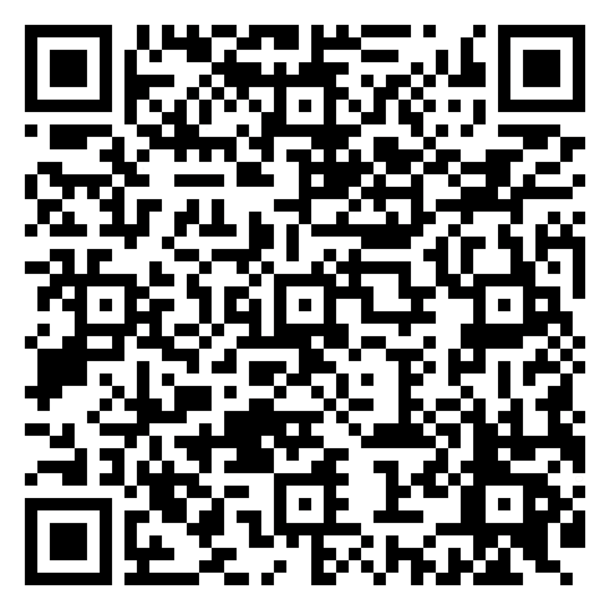
U.S. TALENT GAPS ARE PERSISTENT AND PERVASIVE
46% of U.S. organizations are experiencing workforce disruptions due to worker shortages
Critical industries like healthcare (59%), manufacturing (58%) and education (57%) are the most affected

Slide 3
FOREIGN-BORN WORKERS CLOSE GAPS AND ADD VALUE
65% of organizations with a foreign-born talent strategy report it has been somewhat (53%) or very successful (12%)
73% of employers agree that increased immigration encourages economic growth and U.S. competitiveness

Slide 4
HR RECRUITING DIFFICULTIES
Over half (53%) of HR executives reported difficulties recruiting qualified domestic talent in the last 12 months,
but only 21% of SHRM EN members said their organization has sought foreign talent to address this issue.

Slide 5
WORKPLACES & U.S. ECONOMY BENEFIT FROM IMMIGRATION
96% of organizations report positive experiences with foreign-born workers but only 52% feel the same about the U.S. immigration system
73% of employers agree that increased immigration encourages economic growth and U.S. competitiveness
57% of organizations report that they would benefit from an increase in legally authorized workers on visas

Slide 6
QUESTIONS?
Please use the microphone in the room.

Slide 7
For more information on SHRM’s Global Efforts, please visit SHRM.org, under the Advocacy tab.
Check out our Business Solutions Tab for information on SHRM’s J-1 Program!

