Slide 1
THE NUMBERS THAT WILL DRIVE YOUR YEAR
DR. JAMES ATKINSON
Vice President, Thought Leadership, SHRM
DR. RAGAN DECKER, SHRM-CP
Manager, Executive Network and Enterprise Research,
SHRM

Slide 2
THE NUMBERS THAT WILL DRIVE YOUR YEAR
Dr. James Atkinson​
Vice President, Thought Leadership, SHRM​
Dr. Ragan Decker
Manager, EN and Enterprise Research, SHRM​

Slide 3
KEY NUMBERS DRIVEN BY ENVIORNMENTAL FORCES
#1
Persistent Recruitment
Challenges
Labor
Shortages
#2
Incivility is Common and Expected to Increase
2024
Election
#3
AI is Redefining the
Business Landscape
The Rise of
Generative AI

Slide 4
PERSISTENT RECRUITMENT CHALLENGES
#1
Over 3 in 4
organizations have had difficulty recruiting for full-time regular positions in the last 12 months.

Slide 5
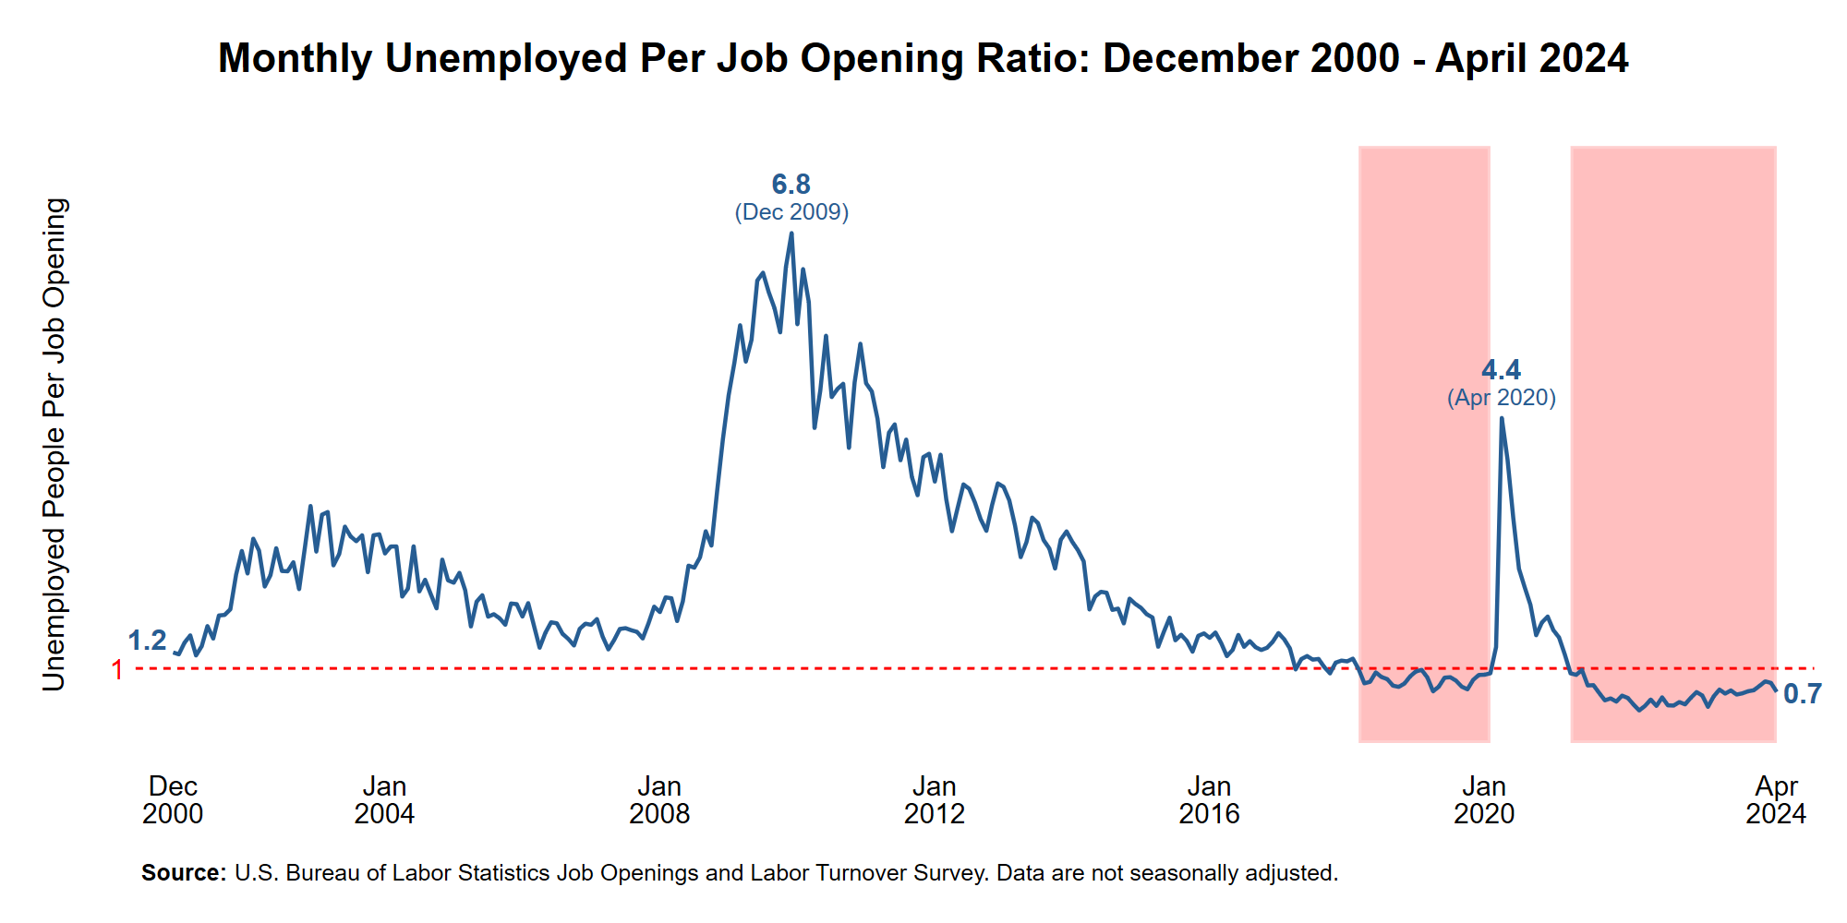
PERSISTENT RECRUITMENT CHALLENGES
#1

Slide 6
INCIVILITY IS COMMON AND EXPECTED TO INCREASE
#2
ZONE 1
ZONE 2
ZONE 3
ZONE 4
ZONE 5
STATE OF
CIVILTY
Incivility is rare
STAY
ALERT
Occasional incivility
TAKE
ACTION
Incivility is common
THIS IS NOT A DRILL
Frequent incivility
CODE
RED
Constant incivility
10
30
50
70
100
42.3
37.5
Q1 SOCIETY AVG. SCORE
Q1 WORKPLACE AVG. SCORE

Slide 7
INCIVILITY IS COMMON AND EXPECTED TO INCREASE
#2
31%
of HR executives say they expect an increase in incivility in the workplace over the next 6 months.
38%
of HR executives say they expect an increase in conflicts and disagreements among employees over the next 6 months.

Slide 8
AI IS REDEFINING THE
BUSINESS LANDSCAPE
#3
Note: HR leaders were asked to select all the changes that apply with the exception of “AI has not changed the business environment.”

Slide 9
AI IS REDEFINING THE
BUSINESS LANDSCAPE
#3
Optimization AI –
Systems designed to improve or maximize efficiency
Enhancement AI –
Systems designed to refine and improve existing content or data
Predictive AI –
Systems designed to analyze historical data and make forecasts
Generative AI –
Systems capable of creating new content based on patterns learned from existing data

