Slide 1
UPSKILLING EXECUTIVE
LEADERS
JEN BUCHANAN
Vice President, Walmart Academy

Slide 2
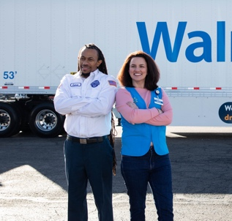
v
2.1
10,500
MILLION
ASSOCIATES
STORES
90%
OF AMERICANS LIVE WITHIN 10 MILES OF A WALMART
255
MILLION
19
CUSTOMERS SERVED WEEKLY
COUNTRIES
Notes:
Privilege of leading Walmart Academy – 1 of largest training ecosystems in country
Training & development from entry-level to C-suite w/Doug McMillon and team
Busy job: 2.1 million associates in 19 countries
Goal: be an academy for talent that produces top-notch leaders

Slide 3
HOW WALMART DEVELOPS EXECUTIVE LEADERS
Creating a consistent, company-wide training strategy
Leveraging pre-hire assessments
3
Delivering a robust onboarding experience
1
2
Instilling culture and leadership development
Establishing community with intentional connections and experiences
4
5
Notes:
Focus today on how Walmart develops leaders
Share tips/tricks that have been successful for us
Important to start with #1: we look at training and development at enterprise level
End-to-end, interconnected strategy

Slide 4
Notes:
Culture of growing our own and promoting from within
Starting point for millions of Americans
2 different populations behind me: but there’s a through-line
75% started as hourly associates
90 former CEOs in past 10 years
Doug has been in both roles – culture is constant
Walmart = best place to build a career from ground up
My team’s job: create more success stories, help the next Doug
Do this with total-company lens through our WM Academy

Slide 5
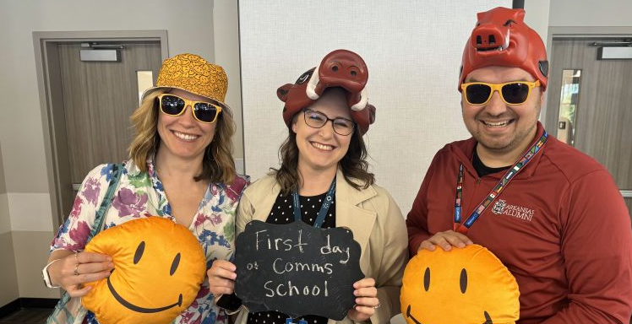
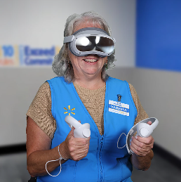
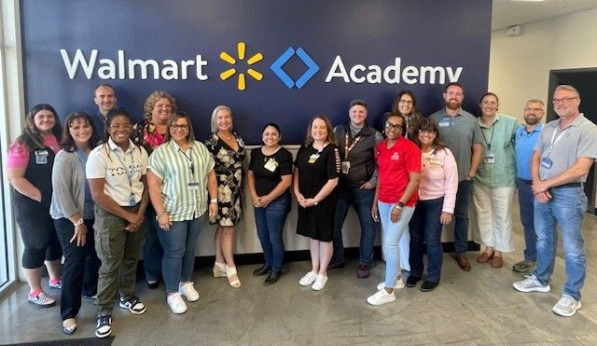
WALMART ACADEMY IS AN TOTAL-COMPANY ECOSYSTEM
Leadership
Lifelong Learning
U.S. CAMPUS
Skills for Today
Skills for Future
U.S. FRONTLINE
Notes:
We think of Academy as a house with different windows
First floor = frontline associates in stores, clubs, supply chain
Second floor = campus and headquarters, including execs
Windows on first floor: 1) skills for today and 2) skills for future

Slide 6
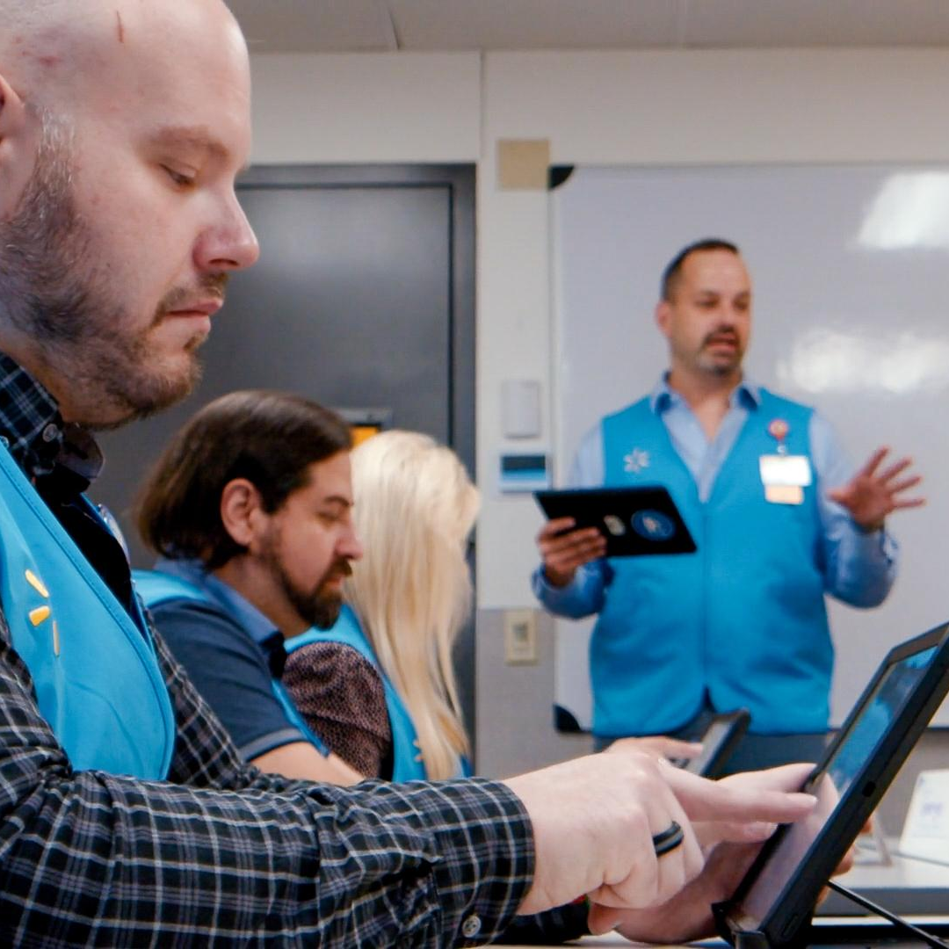
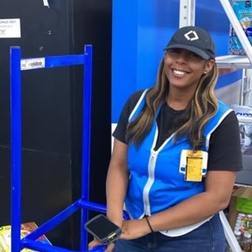
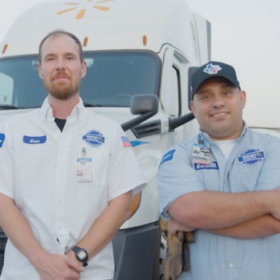
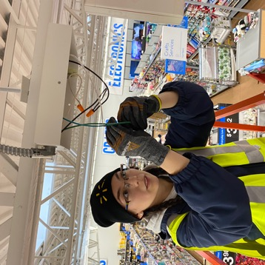
SKILLS FOR TODAY & FUTURE
Seth
Taneisha
Reece
Gabby
DOUBLED SKILLS CERTIFICATES TO
FAST-TRACK ASSOCIATES INTO
ASSOCIATE TO DRIVER PATH FROMFRONTLINE TO TRUCK DRIVER,
MAKING UP TO
ASSOCIATE TO TECHNICIAN PIPELINE TO ROLES THAT MAKE BETWEEN
WALMART ACADEMY TRAINS OVER
300,000
100,000
$110,000
$19-45/hr
ASSOCIATES
EACH YEAR
IN-DEMAND JOBS OVER NEXT 3 YEARS
IN YEAR 1
Notes:
In middle of five-year, $1 billion investment
Seth – one of our 1,500 Academy facilitators across country
Meet people where they are: in-person, VR, app, International
LBU: Doubled skills certificates to fill 100k in-demand jobs
Taneisha story
Pipeline programs like Associate to Driver
Reece story
Associate to Technician is most recent example – Gabby mention

Slide 7
WALMART ACADEMY IS AN TOTAL-COMPANY ECOSYSTEM
Leadership
Lifelong Learning
U.S. CAMPUS
Skills for Today
Skills for Future
U.S. FRONTLINE
Notes:
Second floor = campus associates
Window 1) leadership, and 2) lifelong learning
Intentional about development at every level, because so many leaders have worked through ranks
For our executive leaders, we customize what’s going on
I’ll go back to our 5 points

Slide 8
HOW WALMART DEVELOPS EXECUTIVE LEADERS
Creating a consistent, company-wide training strategy
Leveraging pre-hire assessments
3
Delivering a robust onboarding experience
1
2
Instilling culture and leadership development
Establishing community with intentional connections and experiences
4
5
Notes:
We’ve covered #1
Will spend some time on each of these
We feel strongly about the power of assessments and data
Development should start even before day one

Slide 9
2. LEVERAGING PRE-HIRE ASSESSMENTS
Alignment to company purpose and values
Business simulation
3
Personality traits for leading the business & people
1
2
Notes:
Really smart assessment team – lot of PHDs
Assess for all different jobs – from personal shopper to senior vice president in operations
1) First and foremost, how do they align to values?
2) Business simulation measures management, execution, customer focus, strategic thinking, curiosity, courage, digital transformation
3) Measure 5 personality traits for leading business and people
Introversion/extroversion
Agreeableness
Openness to new experiences
Emotional stability
Conscientiousness
Gives blueprint for IDPs personalized for strengths and weaknesses

Slide 10
3. OFFICER ONBOARDING
3 WEEKS OUT
STARTING DAY 1
WEEKS 1-2
WEEKS 3-4
FIRST 2 MONTHS
DAY 100
Welcome Guide
People Partner Deep Dives
Transition Coach + Assessment Insights
Town Hall with new team
New officer connection event
External executive coach check-in
Notes:
Recently revamped approach; received positive feedback
3 weeks out – Welcome Guide:
Expectations and goals for first 90 days
Hot issues
Peer mentor (very positive feedback)
Day 1: Recurring deep dives to align on business, talent strategy. Weekly at first, then bi-weekly.
Weeks 1-2:
Transition coach for “hard to ask” questions or “hard to find” answers
Assessment debrief and action plan
Hallmark and Coca Cola examples
Weeks 3-4: Town hall w/open dialogue to build trust, set expectations, surface issues
Within 2 months: New Officer connection 1-day experience with cohort of peers
Day 100: external executive coach check-in
Process is standardized but tailored to each officer, role and business

Slide 11
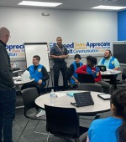
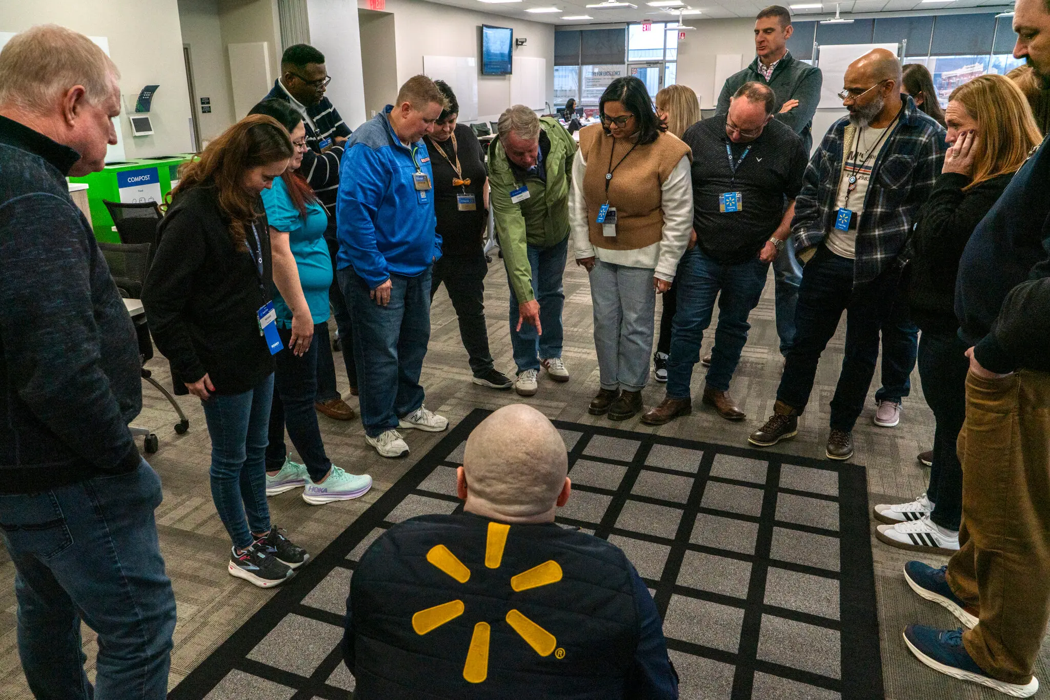
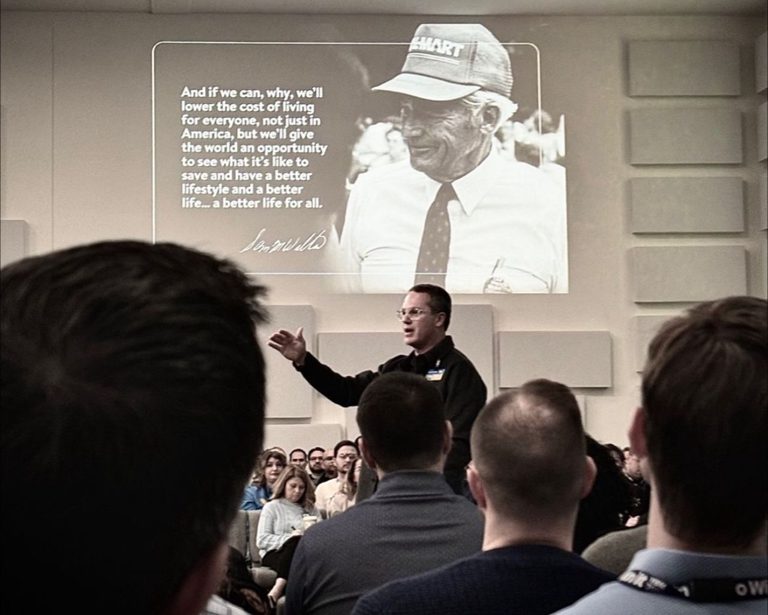
4. Instilling Culture
Hourly Supervisors
Store Managers
Campus Leaders
Notes:
Deeply purpose-driven company: Save people money and time so they can live better
Want everyone to connect to that purpose
President Kennedy/NASA story
Started Manager Academy for store, club, supply chain managers
Great reaction – introduced a version for hourly supervisors and campus leaders
Campus version led by CEO, CFO and CPO – sets tone it’s important
Leaders in charge of taking back to team and leading own training
Regional Vice President example: go through training and then lead others
Creates buy-in and consistency at all levels

Slide 12
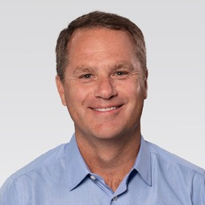
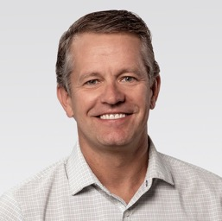
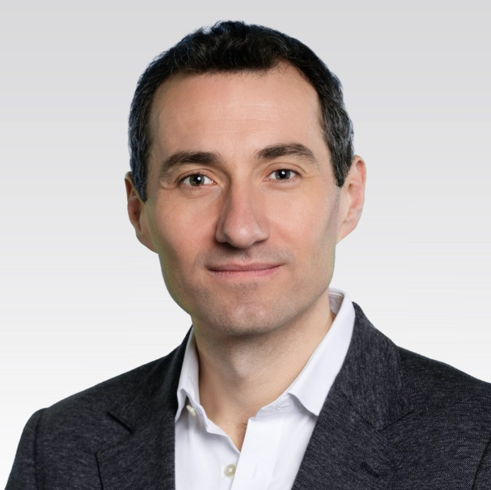
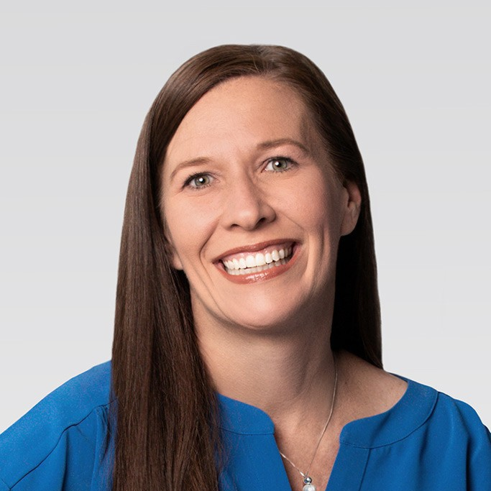
5. CREATING COMMUNITY
Peer mentor
Transition coach
Mentor circles with senior leaders
Sponsorship of Associate Resource Groups
Exposure to different parts of the business
Each worked in every segment of the company
Notes:
Intentional connections and experiences to build the bench
Already talked about peer mentor and transition coach
Mentor circles
Helps leaders navigate business
Doug, our CEO, leads one
Safe space to bounce ideas, form lasting connections, open doors
Encourage leaders to sponsor Associate Resource Groups: groups for military service, pride, disabilities
Explore different parts of business
Doug and other CEOs served in all 3 business segments
Invaluable experience – size and scale comes in handy
Market immersion trips to Chile, Puerto Rico and China
Well-received approach

Slide 13
HOW WALMART DEVELOPS EXECUTIVE LEADERS
Creating a consistent, company-wide training strategy
Leveraging pre-hire assessments
3
Delivering a robust onboarding experience
1
2
Instilling culture and leadership development
Establishing community with intentional connections and experiences
4
5
Notes:
Quick recap
Approach is leading to better engagement, lower turnover, stronger business results
Open it up for questions – happy to also chat afterward

